Slide 1

PRISON EDUCATION AT THE UNIVERSITY OF UTAH
Transformative Intersectional Collective
School for Cultural & Social Transformation

Slide 2
OVERVIEW
Justice Fellows
Enrichment programming
Art Inside

Slide 3
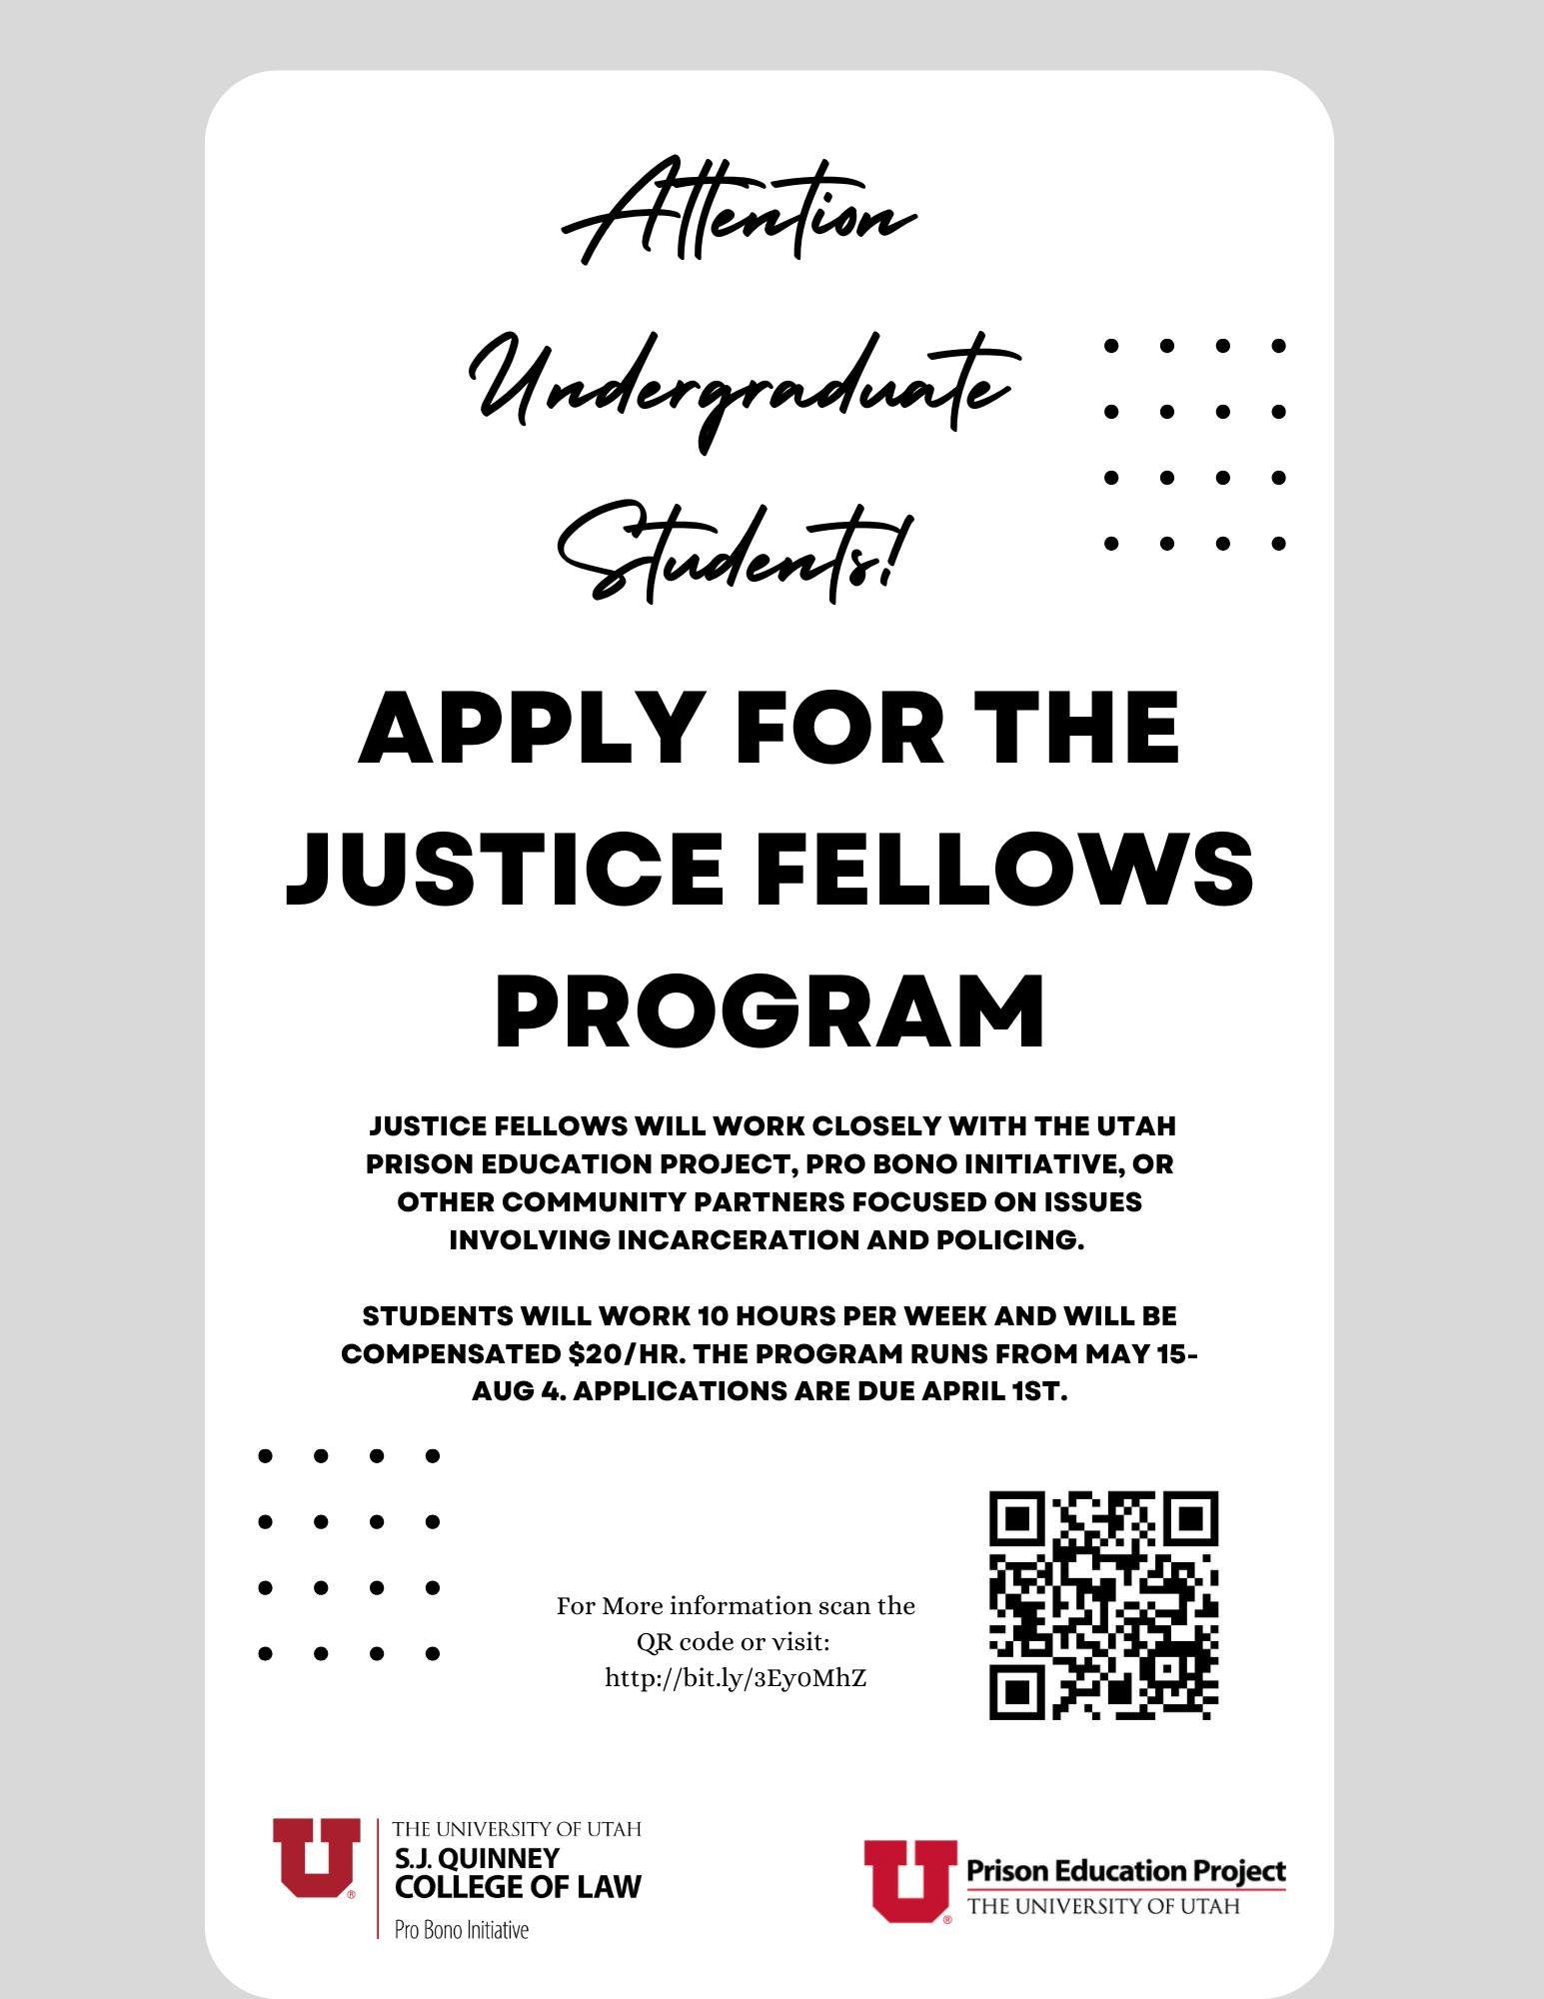
I. Justice Fellows

Slide 4
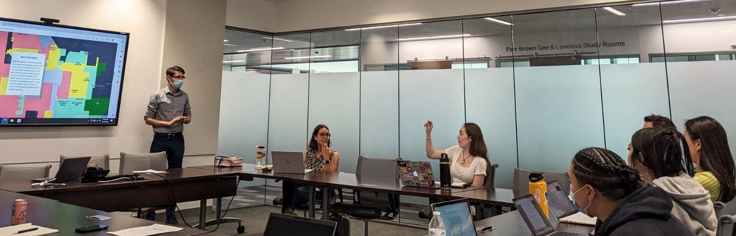

Justice Fellows and UPEP volunteers discuss incarceration, inequality, and prisons during summer reading group.

Slide 5
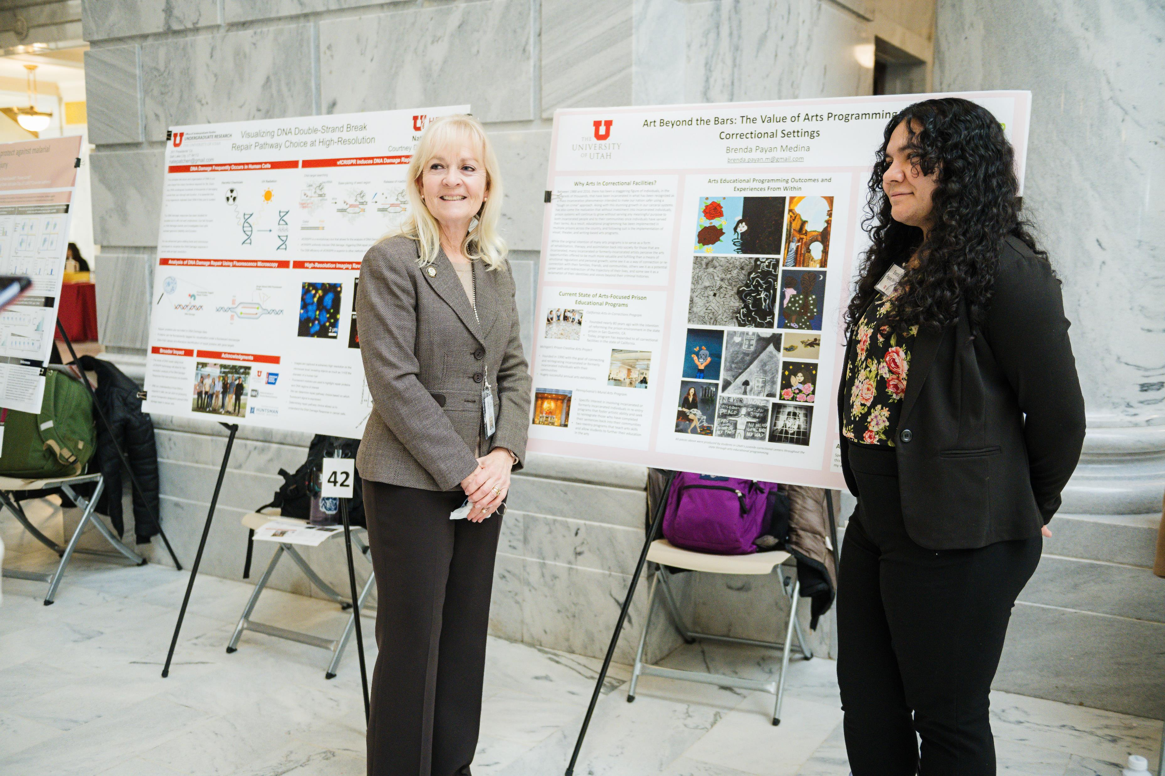
University of Utah undergraduate student and UPEP Justice Fellow, Brenda Payan Medina, presents Art Beyond the Bars: The Value of Arts Programming in Correctional Settings at Research on Capitol Hill.

Slide 6
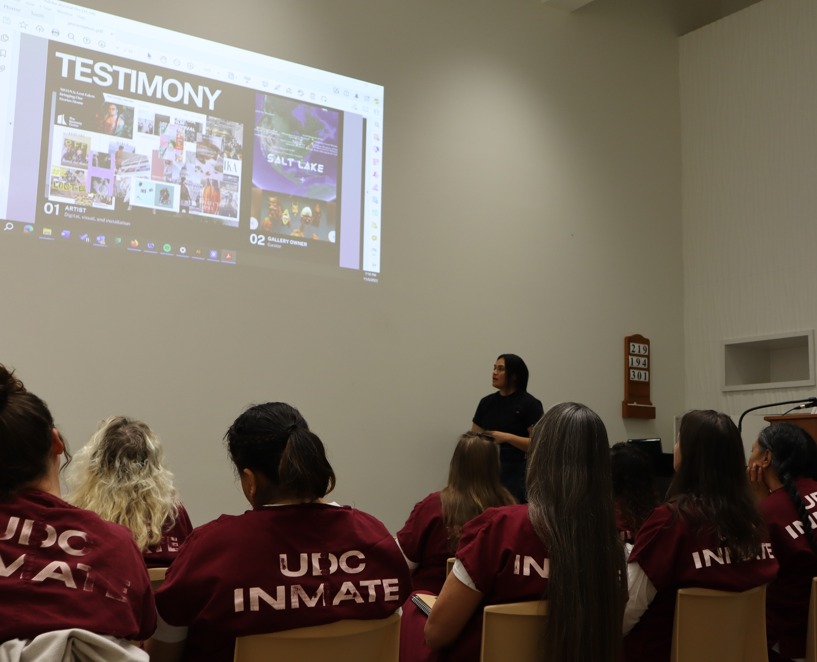
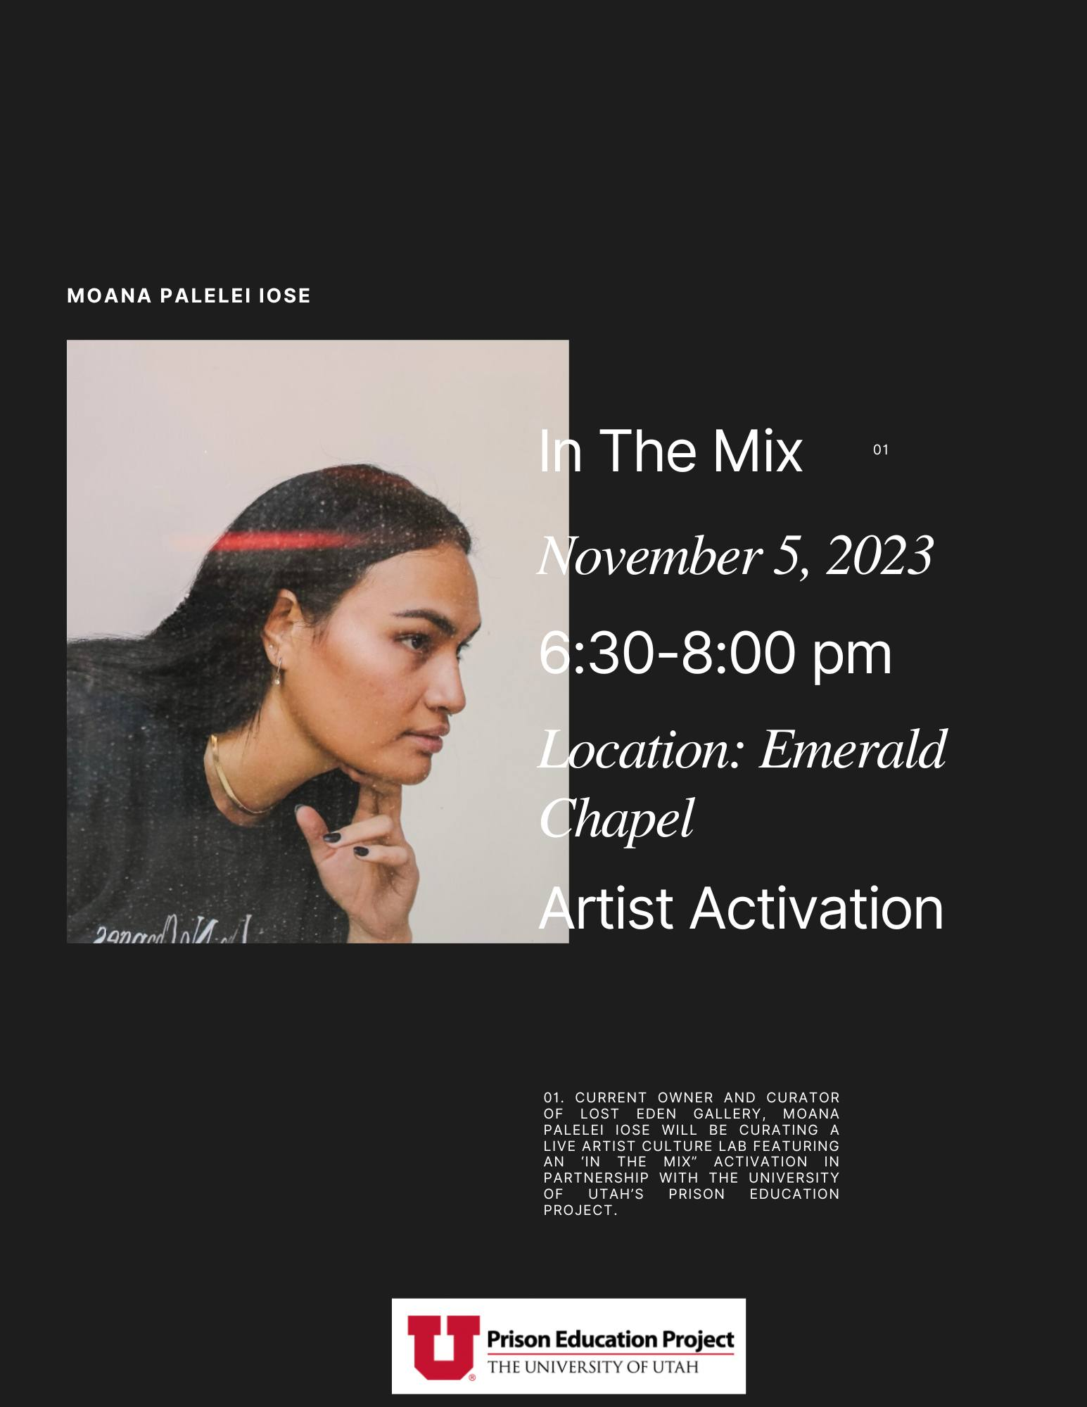
II. Enrichment Activities
Moana Palelei Iose, Artist and owner of the Lost Eden Gallery, presents a workshop at the Utah State Correctional Facility.

Slide 7
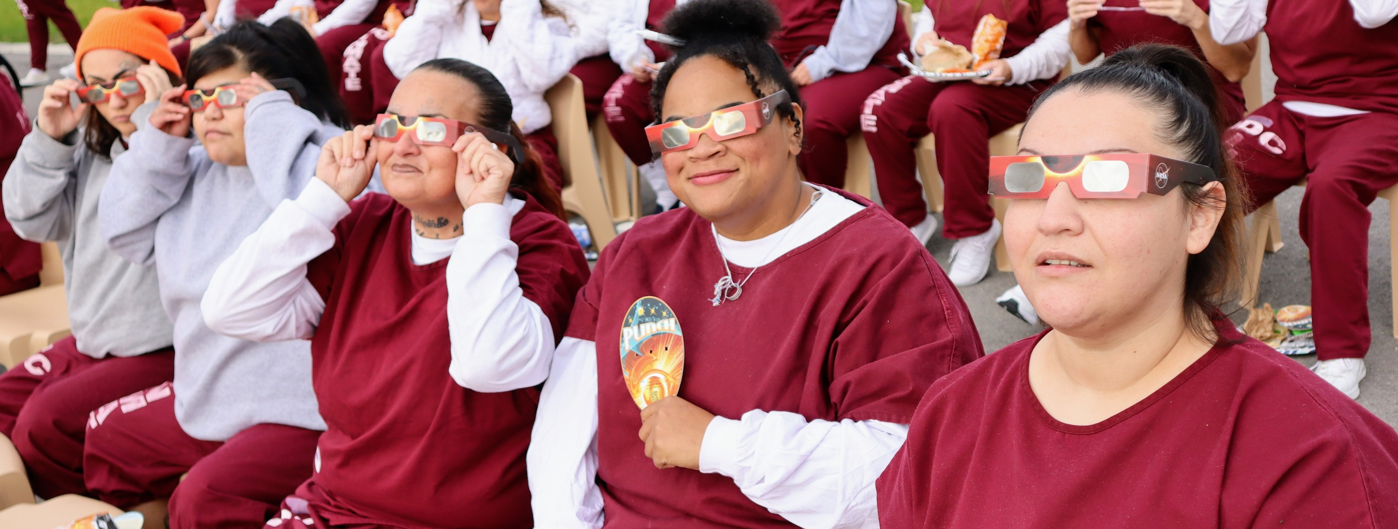


UPEP partnered with NASA to provide 750 people incarcerated in Utah with eclipse glasses. Clark Planetarium offered an eclipse workshop, and we held a viewing party in the women’s designated facility.

Slide 8
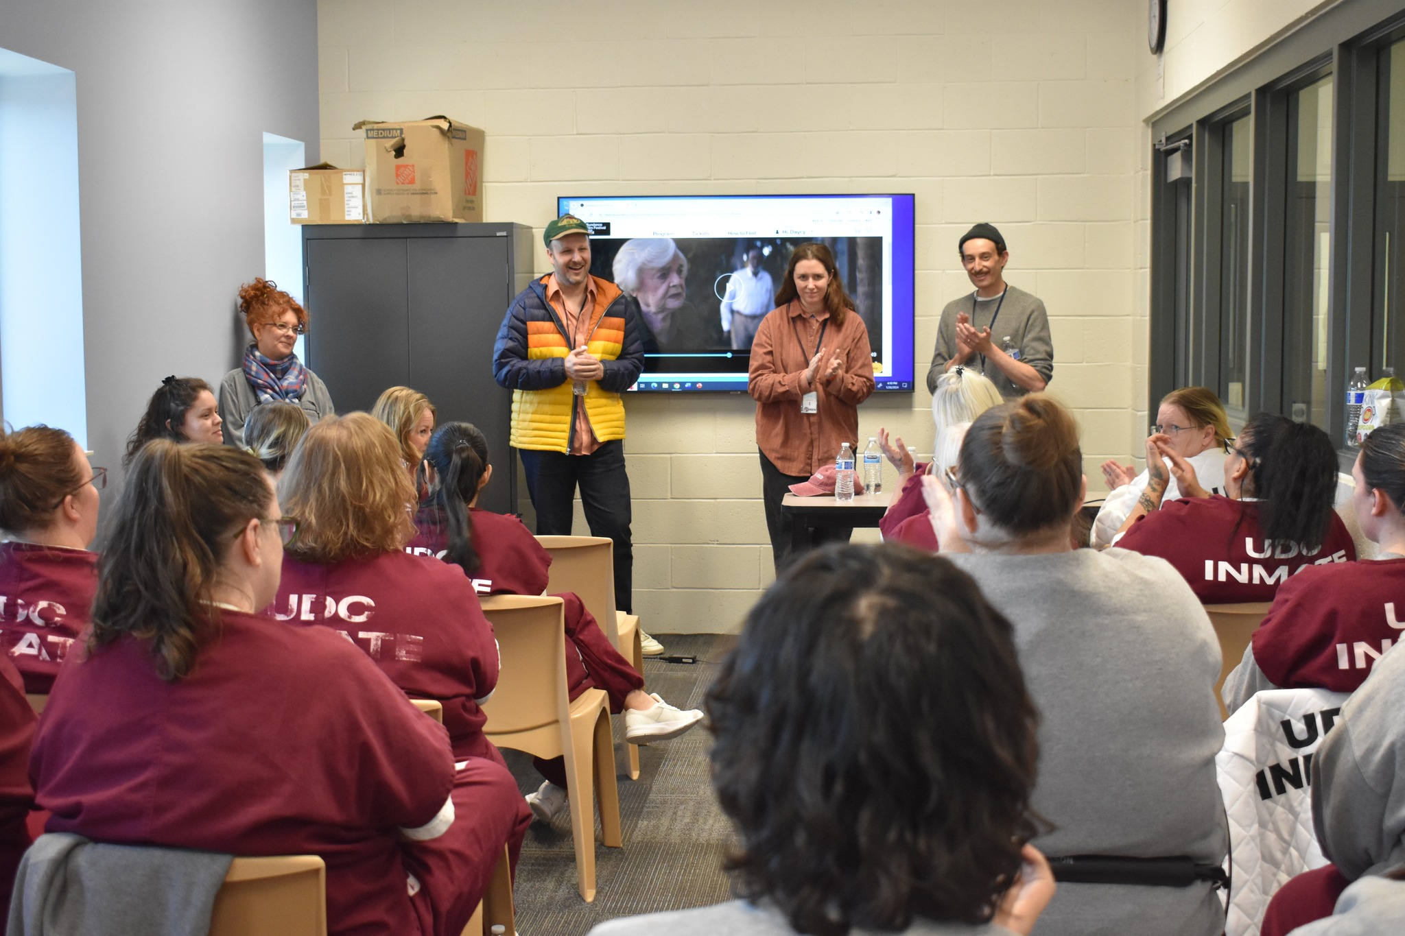
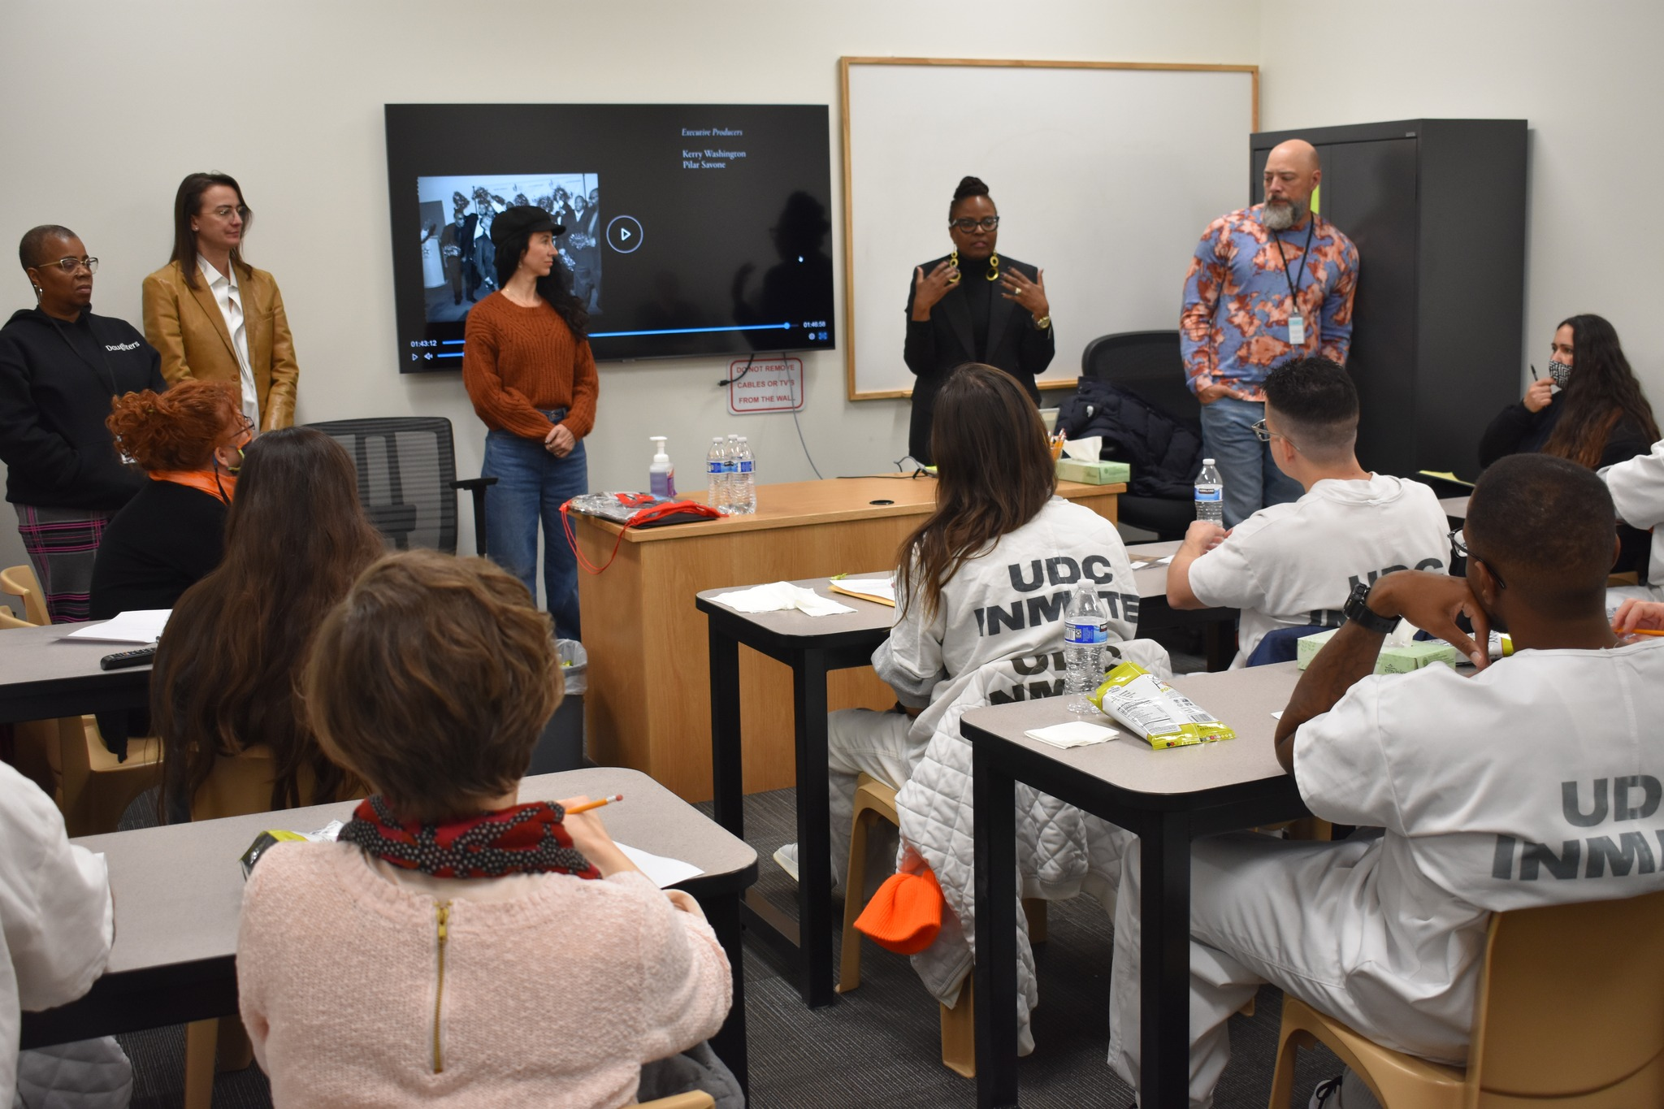


In January 2024, UPEP held the first ever Sundance screenings at USCF with directors and producers from two films, Daughters and Thelma.

Slide 9
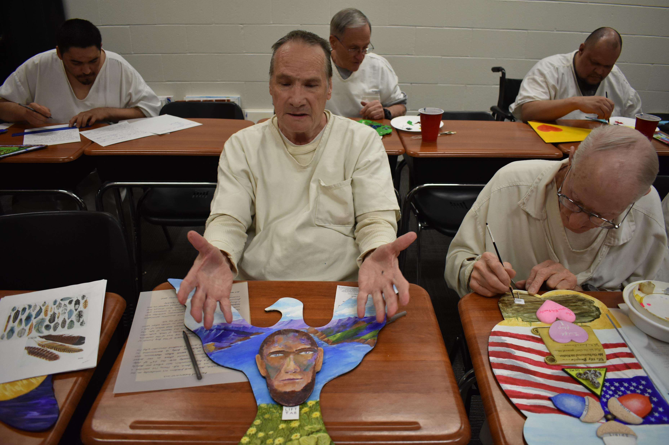
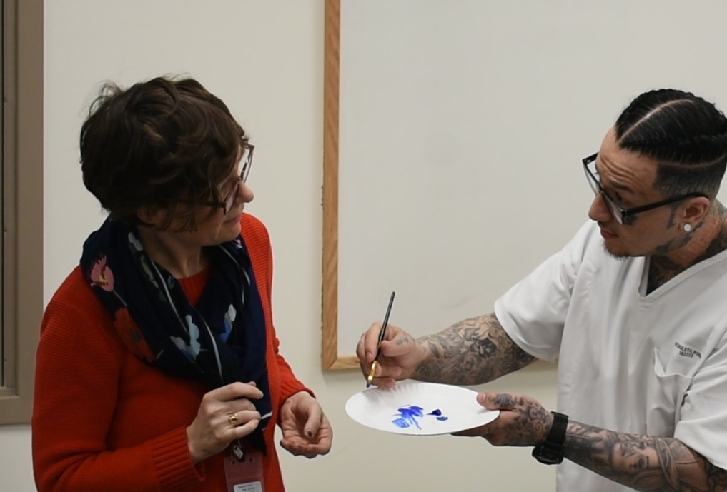
III. Art Inside

Slide 10
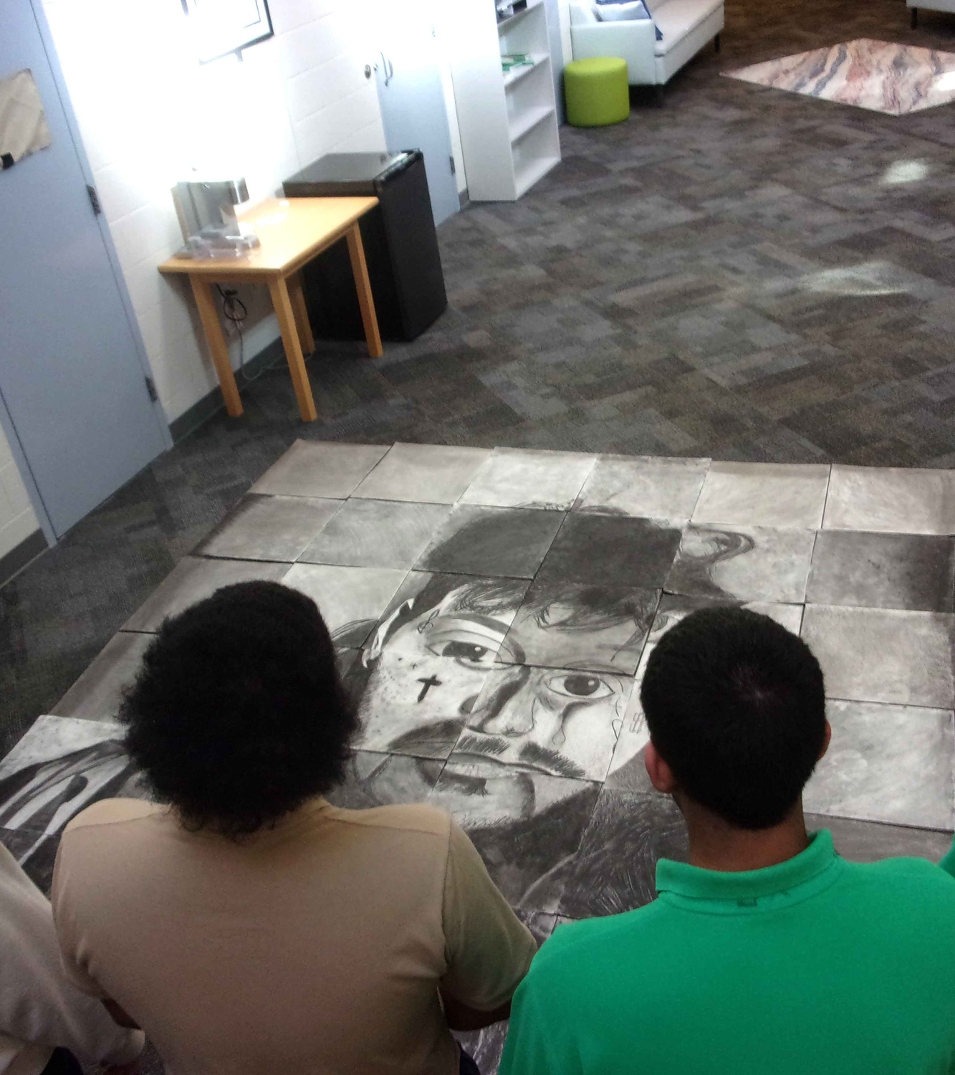

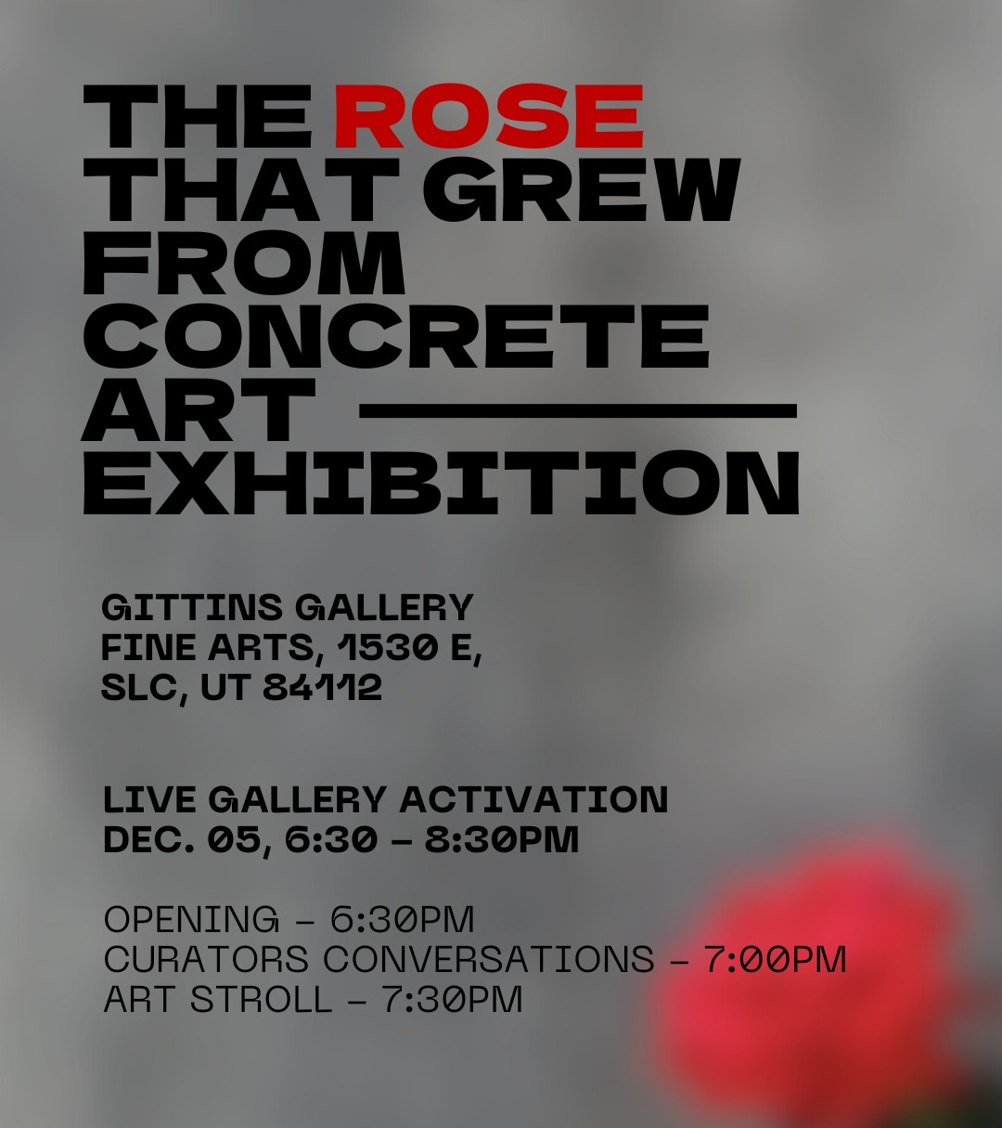

Slide 11
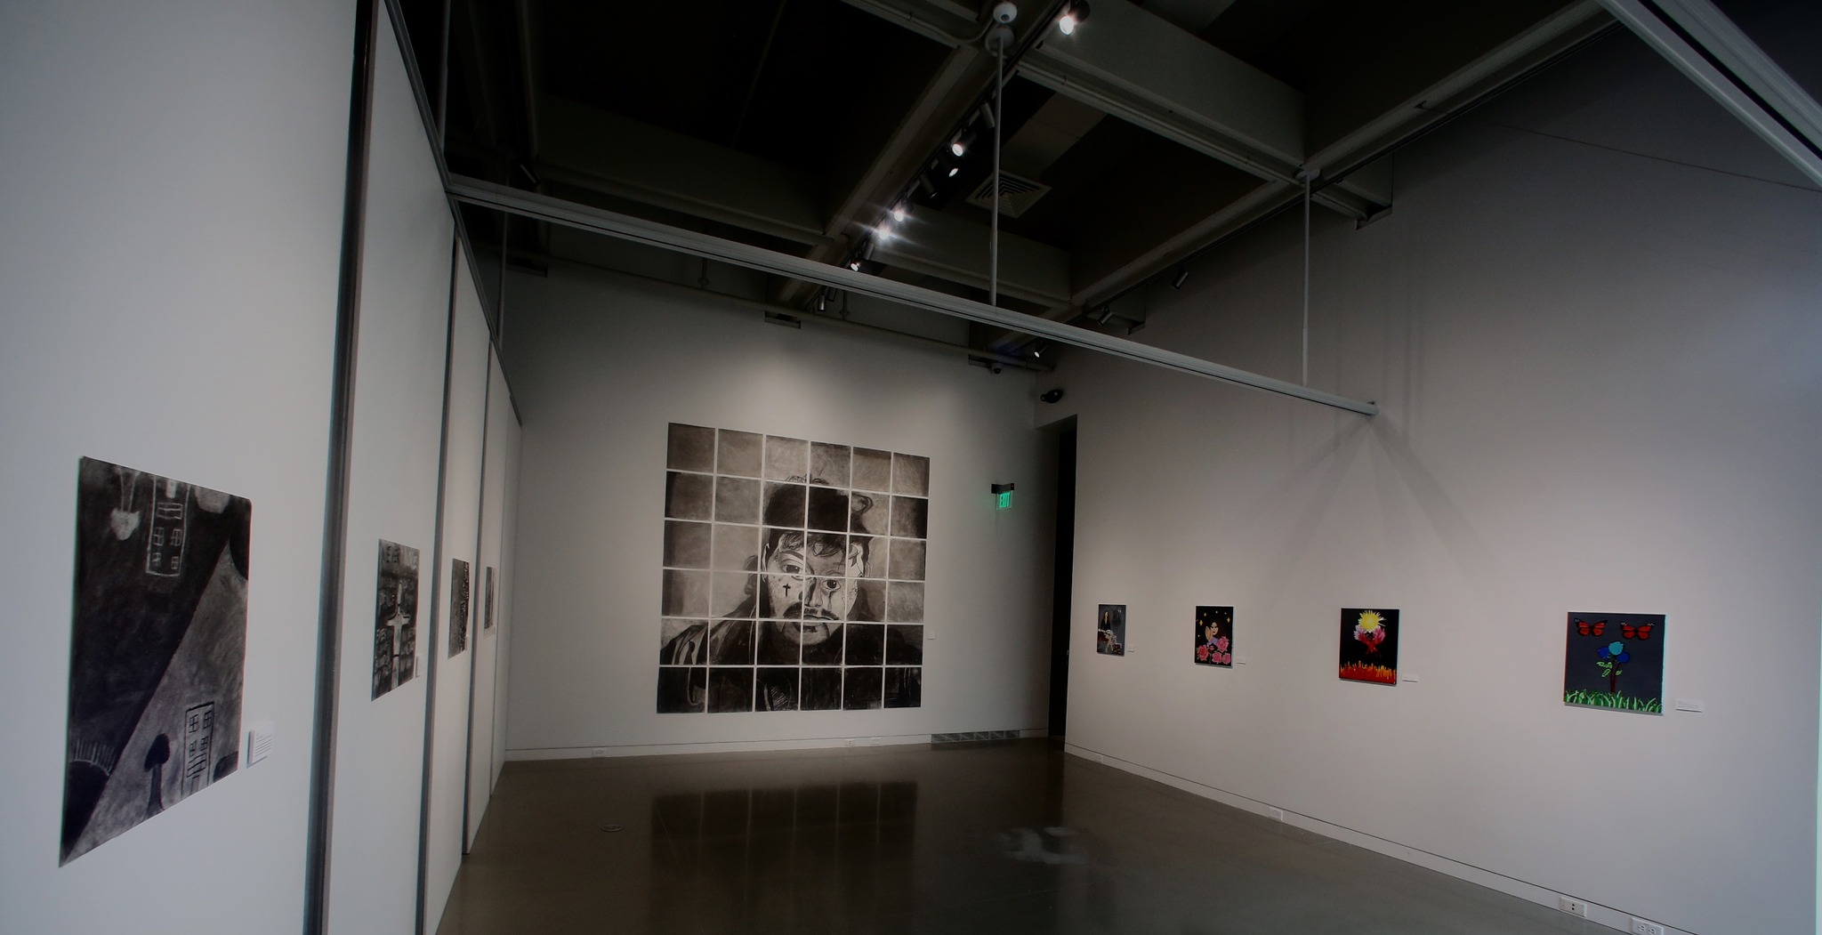

Incarcerated girls at the Farmington Bay Youth Center sing “Scars to Beautiful” while preparing their artwork for the Gittins Gallery at the University of Utah.

Slide 12
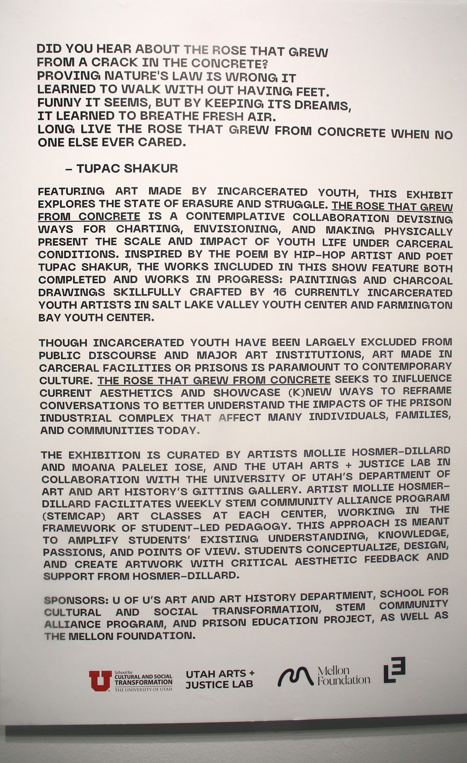
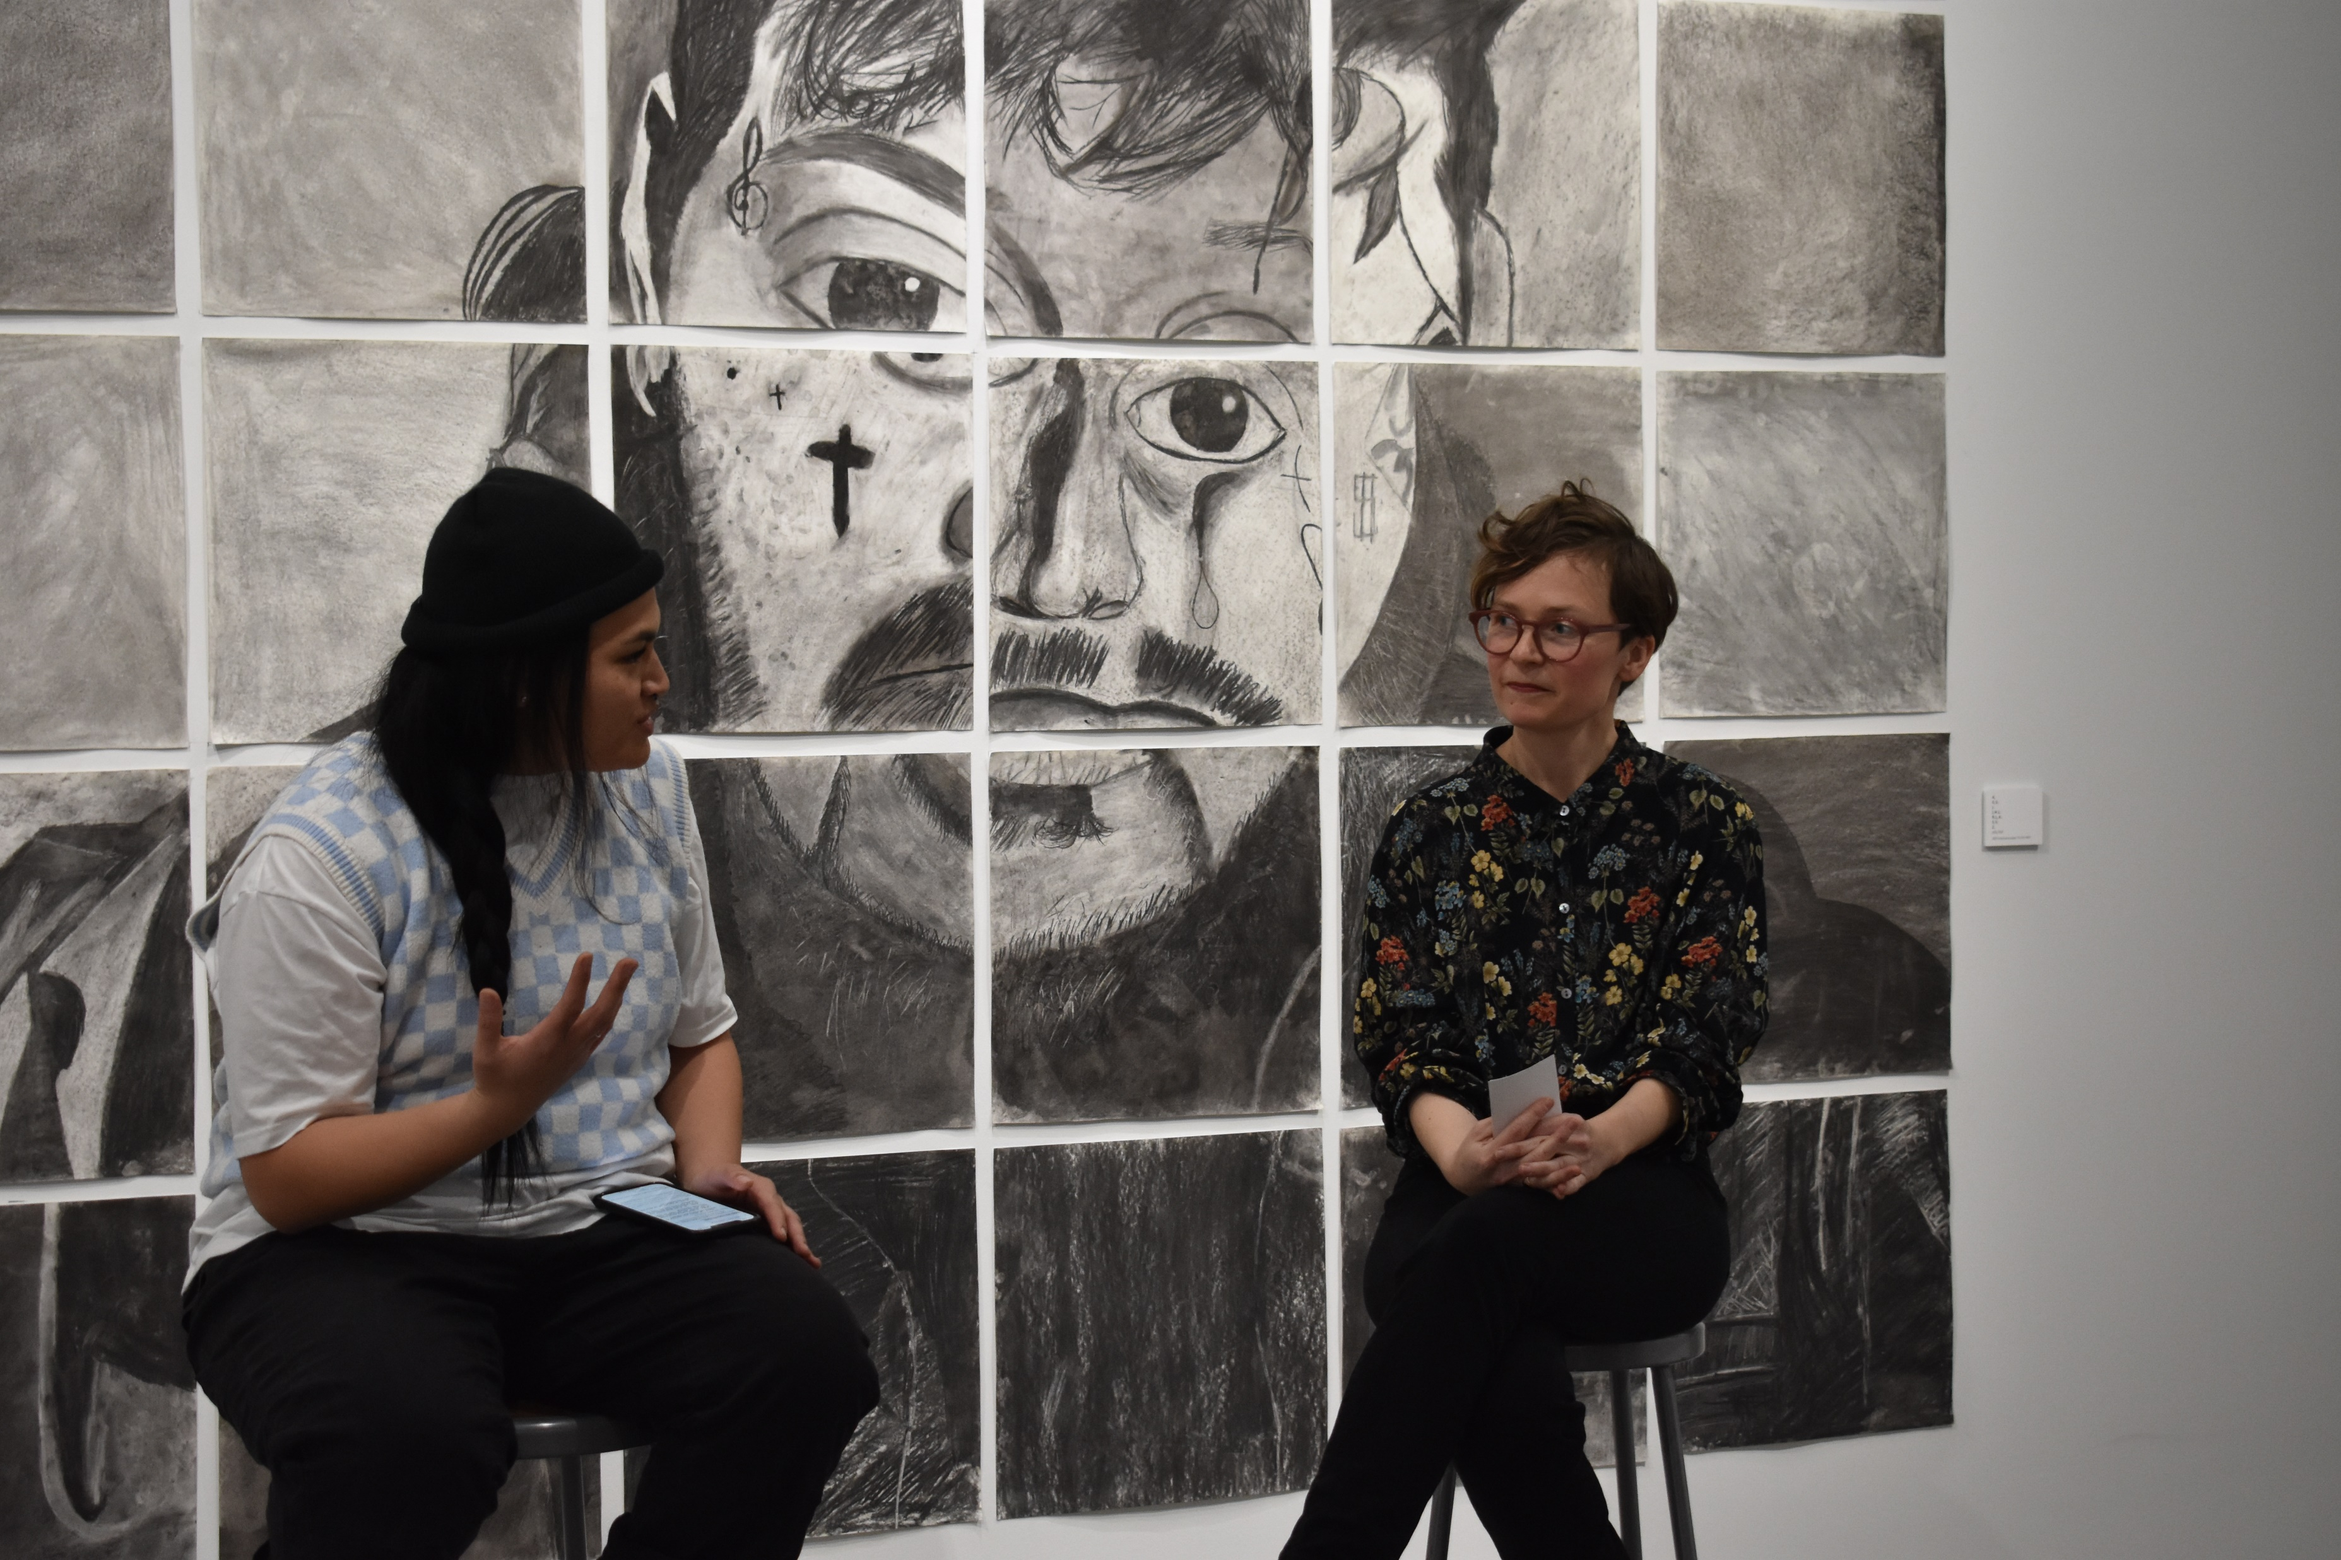
Mollie Hosmer-Dillard and Moana Palelei Iose in conversation at the opening of The Rose That Grew From Concrete, December 5, 2023.

Slide 13
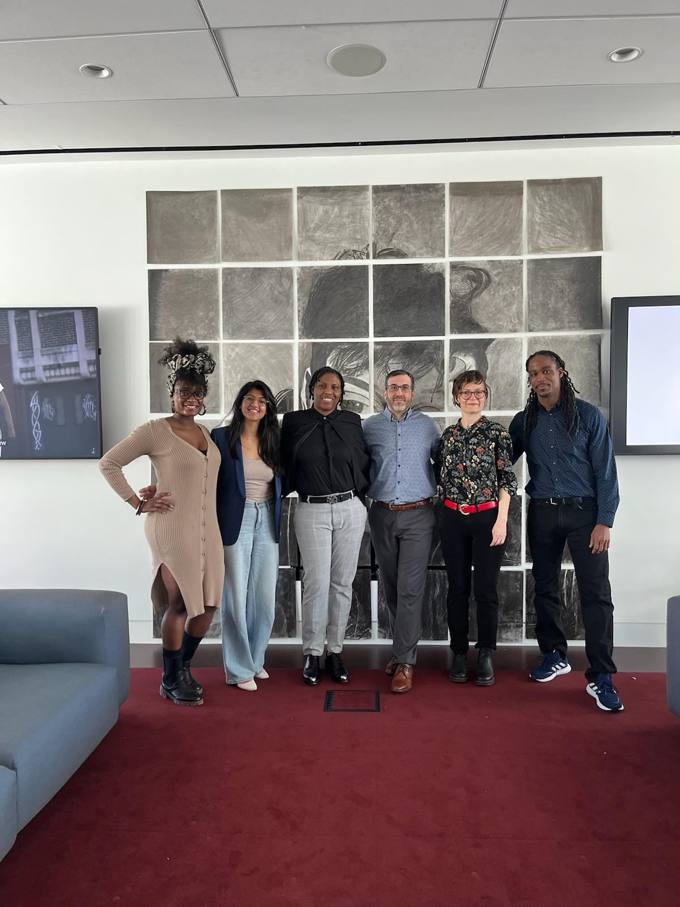
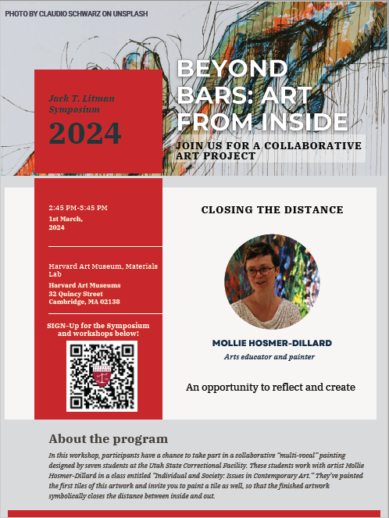
Beyond Bars: Art From Inside
Harvard University
March 1, 2024

