Slide 1
INTERSECTIONALITY AND ENVIRONMENTAL (IN)JUSTICE
Roger Renteria
Department of Sociology
University of Utah

Slide 2
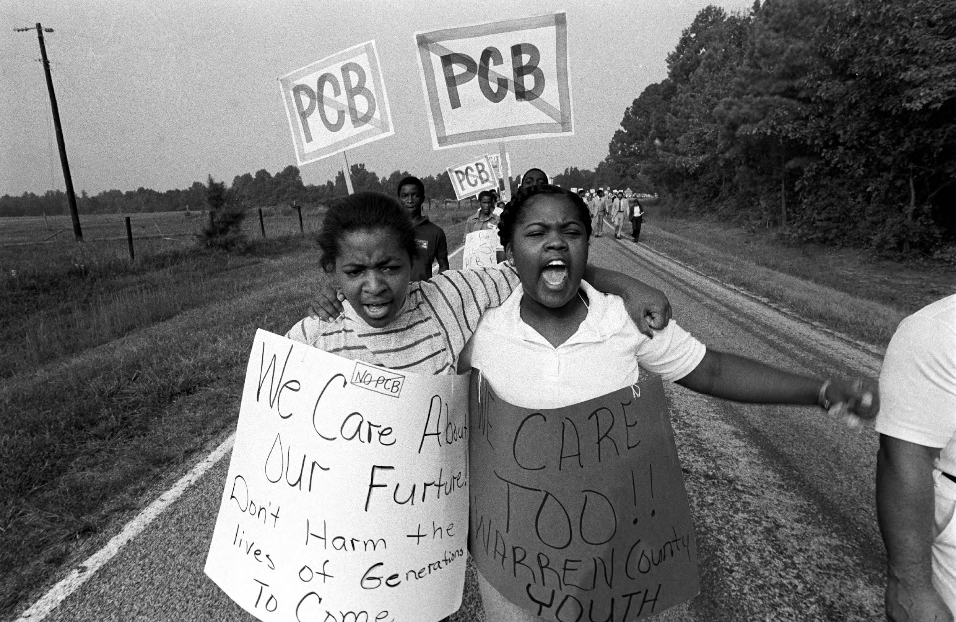
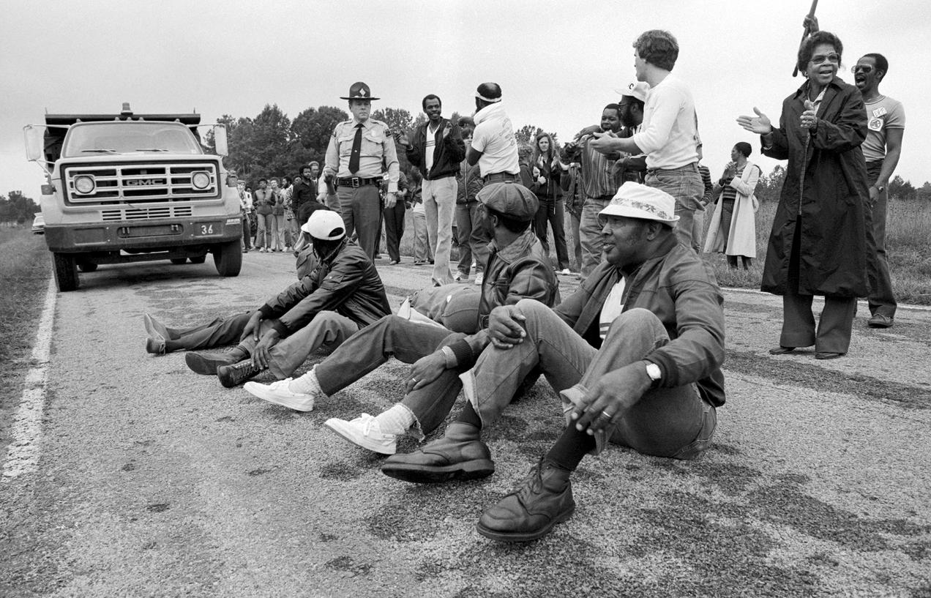
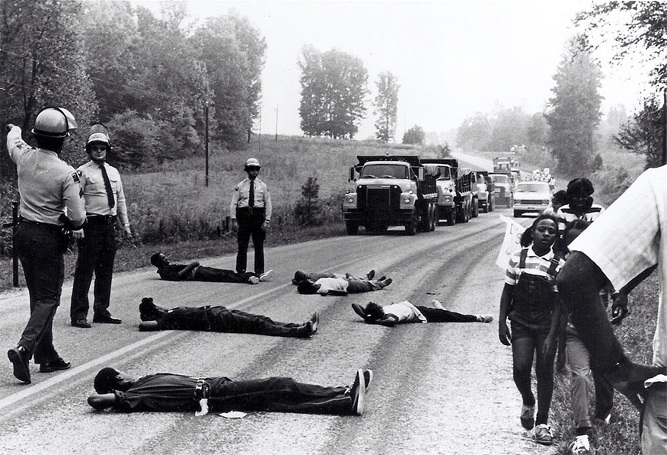
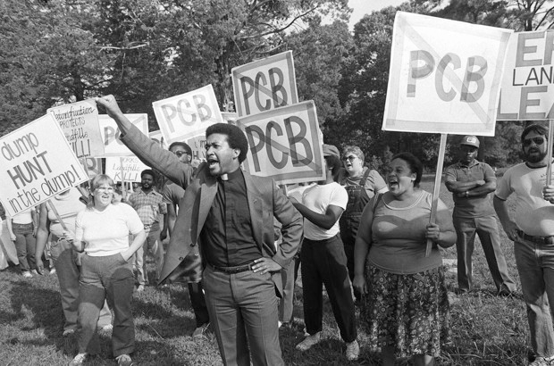
Notes:
The community did not stand by.

Slide 3
Environmental (in)Justice (EJ)
EJ is focused on securing access for all communities to healthy environments in which we live, work, go to school, play, and of recent extension, do time (Bullard 1990; Pellow 2017).
The EJ literature identifies lasting patterns of inequality at various geographical and temporal scales:
environmental hazards
environmental decision-making
environmental amenities
Notes:
As a movement, outgrowth of the Civil Rights movement and response to the environmentalism of the white and affluent.

Slide 4
EJ Studies
First gen: Documented environmental inequalities through the lens of race and class.
Second gen: Extended examinations of distributions of various environmental hazards, included more theory and incorporated more realms of social difference (gender, sexuality, etc.)
Third gen(?): Critical EJ

Slide 5
Some limitations…
assumes homogeneous racial projects for non-white groups
focuses on singular social dimensions (e.g., race versus class) to understand environmental inequalities
Focuses on one scale of injustices
Focuses on policy mechanisms that rely on the state to resolve environmental injustices (reformist)
Notes:
EJ scholarship still has a tendency of focusing on a few forms of social inequality and difference.
Often examine social categories in isolation and does not examine the multiplicative effects of multiple forms of inequality.
Neglecting the complexity of lived reality(ies) and omitting certain communities from a collective struggle.
EJ provides a theoretical framework of analysis, lacks from under-theorization and speaking about the logic of various systems of oppression operationalized by the state, industry, and other political economic forces that designate certain populations and environments as surplus and thus expendable.

Slide 6
Intersectionality
Intersectionality is a theoretical framework originating in Black feminist tradition that brings attention to how interlocking systems of oppression, power, and domination (e.g., classism, racism, sexism, nativism, and ageism (speciesism?)) influence the lived experience of individuals but also pattern the experience of populations (Crenshaw 1989; Collins 1990).
Notes:
As a theoretical framework, intersectionality critiques the reduction of social group domination and subordination to singular categorical identities operating within these aforementioned systems.

Slide 7
Cont.
“focus on particular social groups at neglected points of intersection… to reveal the complexity of lived experience within such groups'' (McCall 2005: 1174).

Slide 8
Background
The general U.S. population is aging.
The subpopulation of older migrants (i.e., those 65+ and foreign-born) is growing.
This aging migrant population is more likely to age precariously than their U.S.-born counterparts.
As an underexamined vulnerable and multiply marginalized population, my research focuses on the environmental injustices experienced by older migrants.
Notes:
There is currently a demographic shift occurring in the United States as the general population is aging.
The subpopulation of older migrants (i.e., those 65+ and foreign-born) is growing and is projected to account for 23 percent of the older population in the United States by 2060 (Mizoguchi et al. 2019).

Slide 9
Cont. Migrant Population
Migrants are a socially vulnerable group
potentially precarious documented status
may experience linguistic isolation (i.e., not speaking English well)
more likely to live in poverty
racialized and affected by xenophobic rhetoric and policy
Notes:
The focus in the literature on migrants and environmental hazards has been dominated by work on seasonal migrant farmworkers (geographically and industry specific).
In addition to potentially experiencing environmental injustice in the workplace, migrants can also experience environmental injustice outside of the worksite in their communities

Slide 10
Cont. Aging Population
■ The older population is particularly vulnerable to the impacts of environmental and climatic hazards like fine particulate matter (PM_{2.5}) or extreme heat and cold that can further exacerbate health problems.
Treated as homogenous group

Slide 11
Cont. The Aging Migrant
The majority of older migrant have spent the most of their working age (25-64) in the United States.
Omitted as a vulnerable group in environmental justice literature.

Slide 12
Research Methods and Questions
Distributive Environmental Injustice study: Quantitative analysis
Using restricted individual level sociodemographic data to create intersectional identity variables (race by nativity and citizenship status and gender)

Slide 13
Research Methods and Questions
In-depth interviews
How do aging migrants embody their work and environment?
How does nativity, immigration status, (dis)ability status, gender, race/ethnicity inform the type of work and places that migrants live?
Similarly, what are some examples of resistance and resilience to inequality practiced by people?

Slide 14
Thank-you!

